Slide 1


Big Apps Challenge V2.0
Framework and Scope

Slide 2
Big Apps Challenge Objectives
Drive big data adoption by harnessing the power of big data analytics to solve Malaysia’s challenges
Ignite the interest of developers, local companies and startups in BDA thus developing more local uses cases
Provide a platform to increase awareness to the concepts of BDA through ideation workshops and mentoring
Build the local BDA industry by providing the jumpstart to the local software economy in BDA
Quick wins in developing local talents in BDA and Data Driven Analytics solutions

Slide 3
BAC V1.0 Process Flow
29 Sept
Launch of Big Apps Challenge 1.0
13-19 Oct
Ideation workshop
20 Oct – 20 Nov
Big Apps Development (4 weeks)
20-21 Nov
Submission of Big Apps
27 Nov
BAC Finals Judging Sessions
15 Dec
Award Event with BDA Conference
12 Sept
Website and invitation
Registration starts
Press release
23 Sept
eDM & Community announcement

Slide 4
BAC V1.0 Achievement
 | Goal | Final
Registration | 100 | 225
Submission | 40 | 21
Finalist | 10 | 10
Media | 3 | 7 +
Finale | 100 | 150

Slide 5
BAC V1.0 Participants Analytics
Summary
The Big App Challenge had a very good response from teams as well as companies with registration totaling 225
The challenge encouraged a lot of people to form teams (68% of registrations)
Response from the email blast and press coverage helped drive the attendance
Email to MSC Companies
Eventbrite – ideation 2
Press Release
Eventbrite – ideation 1

Slide 6
Ideation Workshop BAC V1.0
Summary
The ideation workshop is planned to help teams and companies prepare for the big app challenge. We had a great turnout (94 pax) that’s beyond our target of 70. The attendees were very interactive. Presenters from Tentspark, IBM and Teradata. Venue was conducive and the only major drawback on the internet bandwidth.
The ideation workshops objectives :
Provide basic knowledge on Big Data Analytics and the platforms that teams can develop on
Provide a forum for discussion and sharing of ideas
Foster a community of like minded people
Event information
Ideation workshop (1)
Venue : TM Convention Centre
Date : 13-15th Oct 2014
Attendance : 30 pax (45 registration)
Ideation Workshop (2)
Venue : Exabytes
Date : 18-19th Oct
Attendance : 64 pax (96 registration)

Slide 7
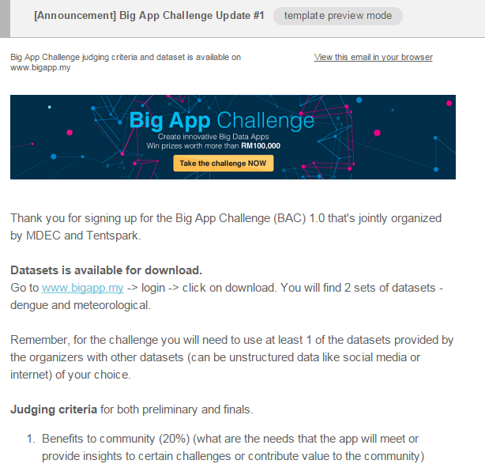
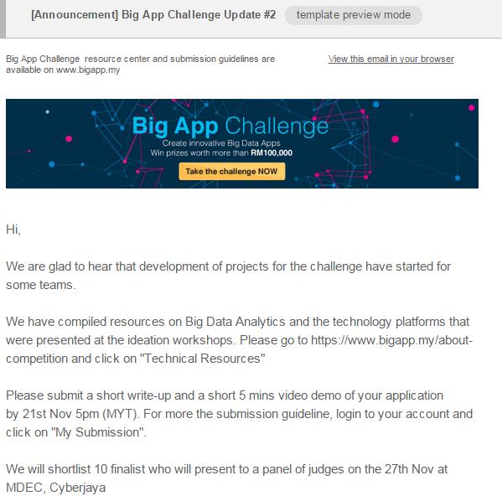
BAC V1.0 Development
Issue | Date | Description | Qty | Open % | Click thru %
1 | 22 Oct | Update on dataset & judging criteria | 226 | 54.9 | 13.8
2 | 4 Nov | Update tech resources & submission | 225 | 55.4 | 3.1
3 | 19 Nov | Final Reminder | 225 | 54.9 | 3.6
Summary :
BAC emails during development was well received :
Open rate above 54% vs 12%
Click thru 3.1-13.8% vs 2%
2) Content : useful information and reminder
3) Same format and simple

Slide 8
Big App Challenge V1.0 Judging Session
Objective
The committee handpicked top 10 to present and showcase their development in front of 6 judges which are from public, private and Big Data Community
Summary
1) In general, the finals was done well. Venue was good.
2) The judges were objective and judged well
3) Managing timing of teams at times was difficult but managed well
Winners :
MMU – Teradata Team
APU Team
PetaInsights
Judges : 6 persons from government agencies and industry
Learnings :
1) Many teams didn’t have time to demo their solution. Besides giving them a guideline, we could arrange for the teams for in-person briefing.
Time | Agenda
8.30 AM - 9.15 AM | Breakfast and Pre-judging briefing.
9.15 AM - 9.30 AM | Opening Remarks by Ir. Dr. Karl Ng Director, Innovation Capital, MDeC
9.30 AM – 11.00 AM | Presentation by first 5 companies Order of Presentation: Kok Boon (Outbreak Analytics) Goh Qing Yi, Craig Morrison (Denggue Index Web) Right Link Solution (Big App Demo on mobile and web) Wendy Tan Wei Syn (Dengue Analytics) Chong Li Ken (Consolidated Information System For Case of Dengue)
11.00 AM – 11.15 AM | Break
11.15 AM – 1.00 PM | Presentation by second 5 companies Order of Presentation: Hema Latha Krishna Nair, Ian Coushanga (DAM-IT apps) Foong Chee Mun (Dengue iPortal) Muhamad Abdul Hay bin Sulaiman (Dengue Early Warning System) Tan Kean Seng (PetaInsights) HeiTech E*Business Solution Sdn Bhd (Big App Challenge 1.0)
1.00 PM | Networking Lunch
2.00 PM | Judging Result Announcement

Slide 9
BAC V1.0 Judging Criteria
Dataset (10%)
Originality (10%)
Functionality (10%)
Benefit (20%)
Stability (20%)
Visualization (30%)

Slide 10
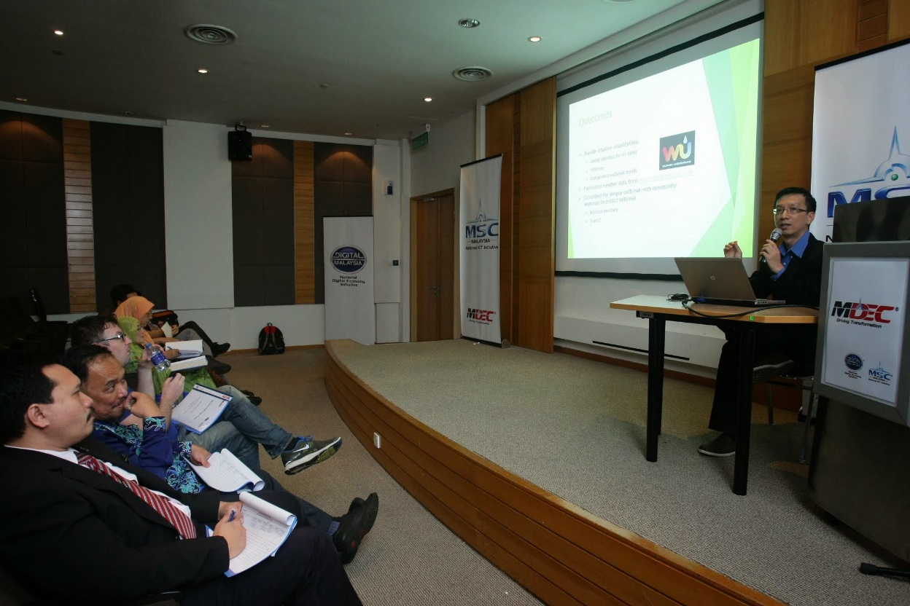
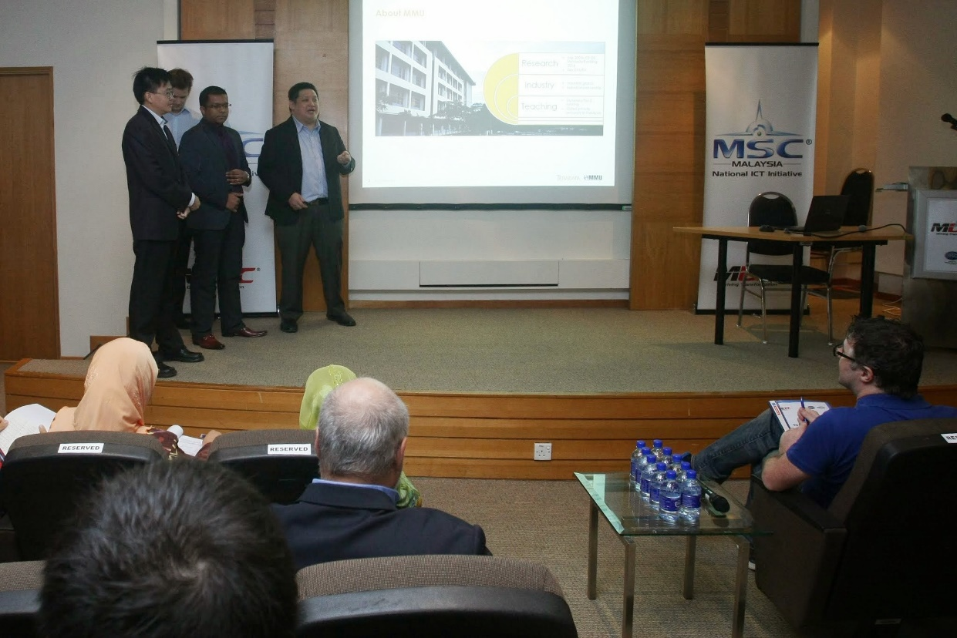
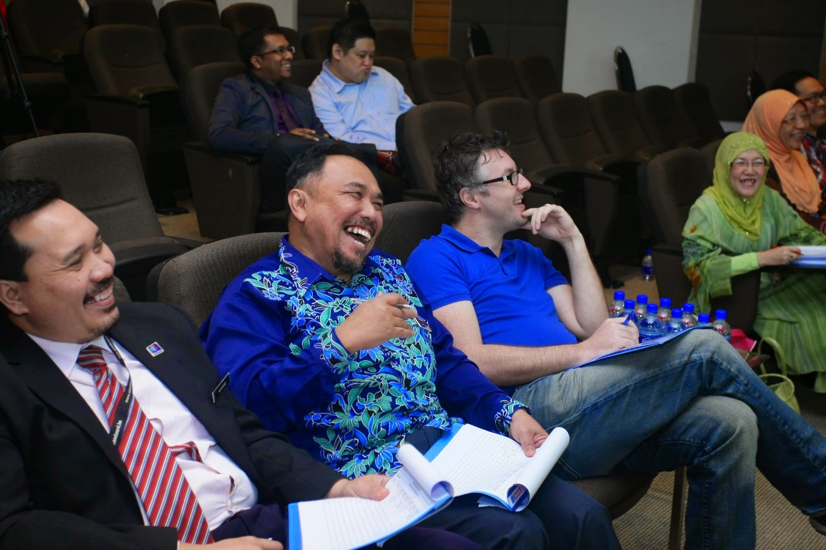
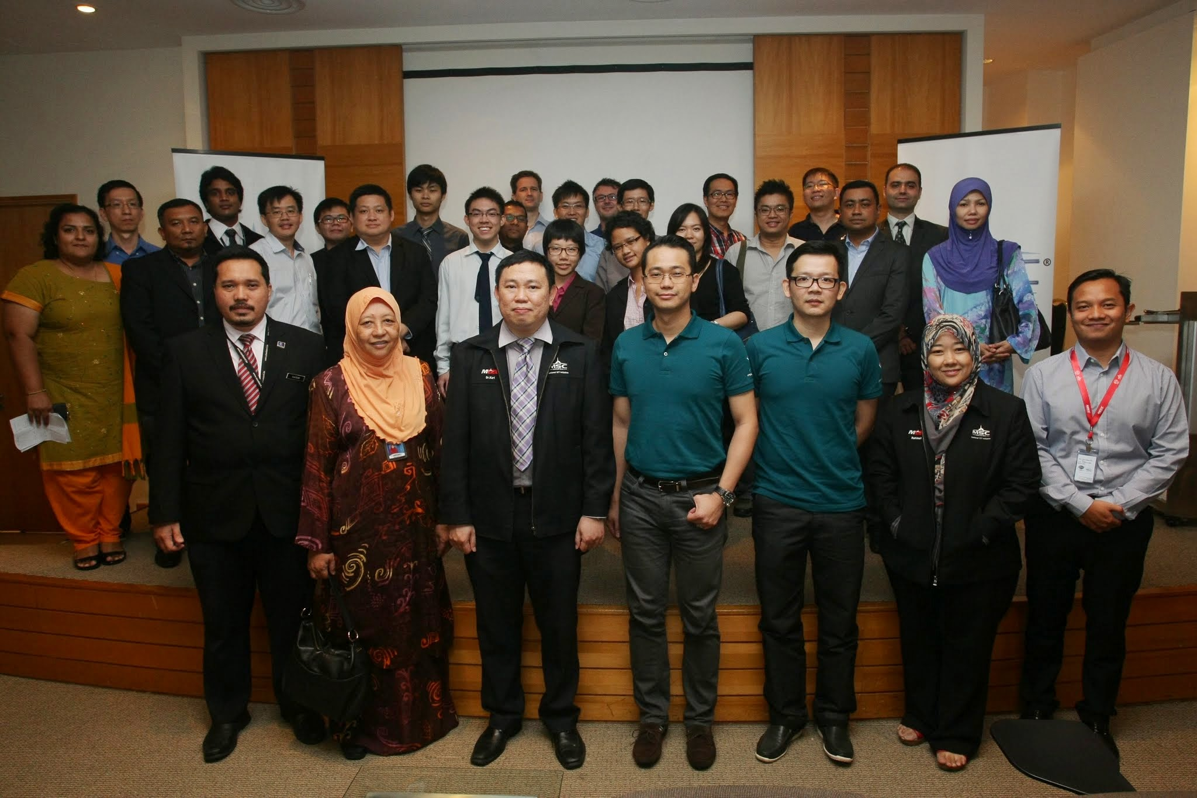
Big App Challenge V1.0 Judging Session

Slide 11
BDA Conference and Award Ceremony
Event Summary
Well attended by 150 pax
Date : 15th Dec 2014
Venue : Le Meridien Hotel
We had a exhibition area with 4 finalist and 3 winners showcasing their Big App solutions
Overall satisfaction – 98% satisfied -> very satisfied
Time | Agenda
8:30am | Registration
9:30am | Opening Remarks by Multimedia Development Coorporation (MDeC) Dato’ Yasmin Mahmood, CEO, MDeC
9:40am | Prize Presentation to the Winners of National Big App Challenge 2014
10:00am | Open Data Business Models – “UK Experience” Ms. Liz Carolan, International Development Manager, Open Data Institute, United Kingdom
10:30am | Emcee will be inviting Dato’ Yasmin to a booth walkabouts at the exhibition area.
10:45am | Break and Networking
11:05am | How Big Data Plays a Part in TM Innovation Ecosystem Mr. Giorgio Migliarina, Chief Technology and Innovation Officer, Telekom Malaysia
11:35am | Open Data – Privacy Challenges and Trends Dr. Dzaharudin Mansor, National Technology Officer, Microsoft Malaysia
12:05noon | Knowledge is Power – The importance of big data integration and analytics in the Logical Data Warehouse Mr. Szilard Barany, Principal Technology Consultant, Teradata
12:35pm | Lunch and Networking Session

Slide 12
Stats BDA Conference and Award Ceremonies
General
79% evaluations gathered – 119 forms
60% Small to Mid size (<500) companies
28% are decision makers
6% are data scientist
Content prepared are relevant to the audiences

Slide 13
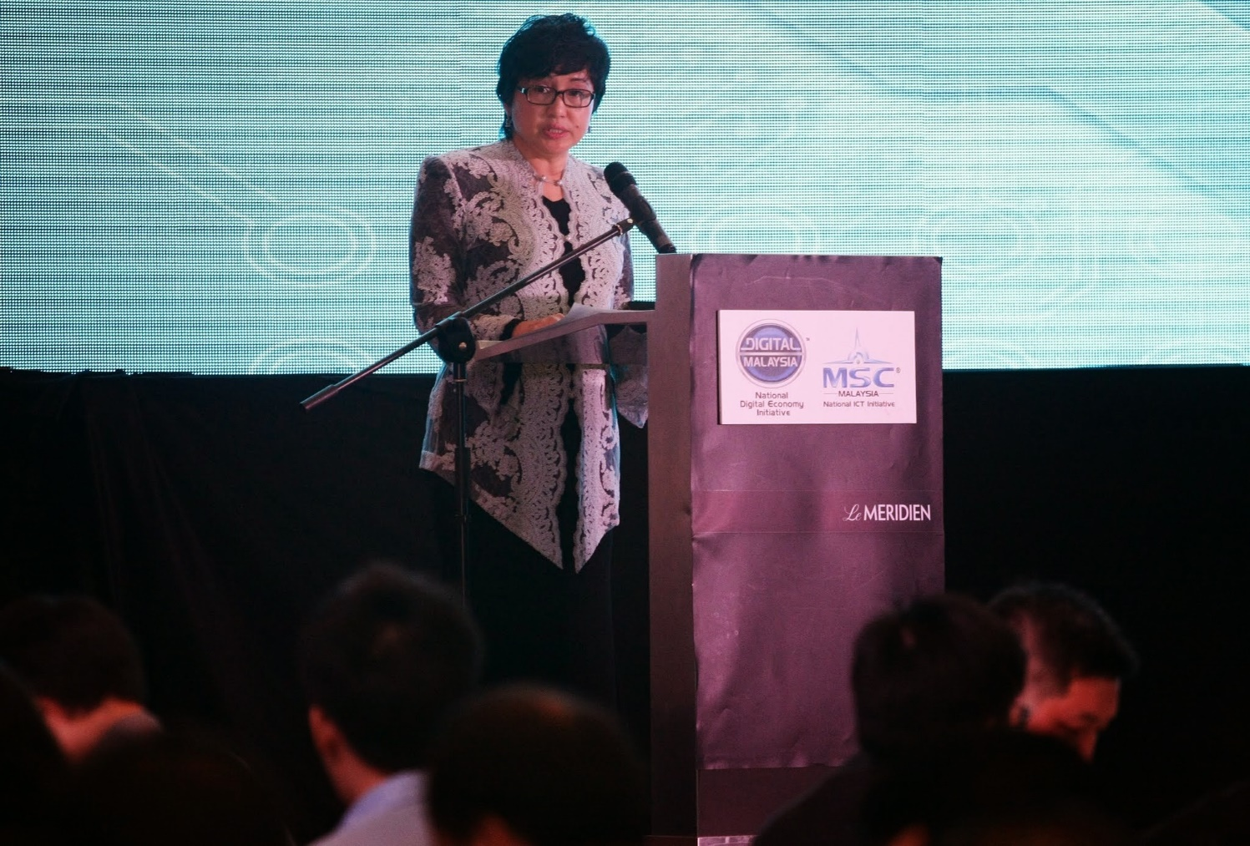
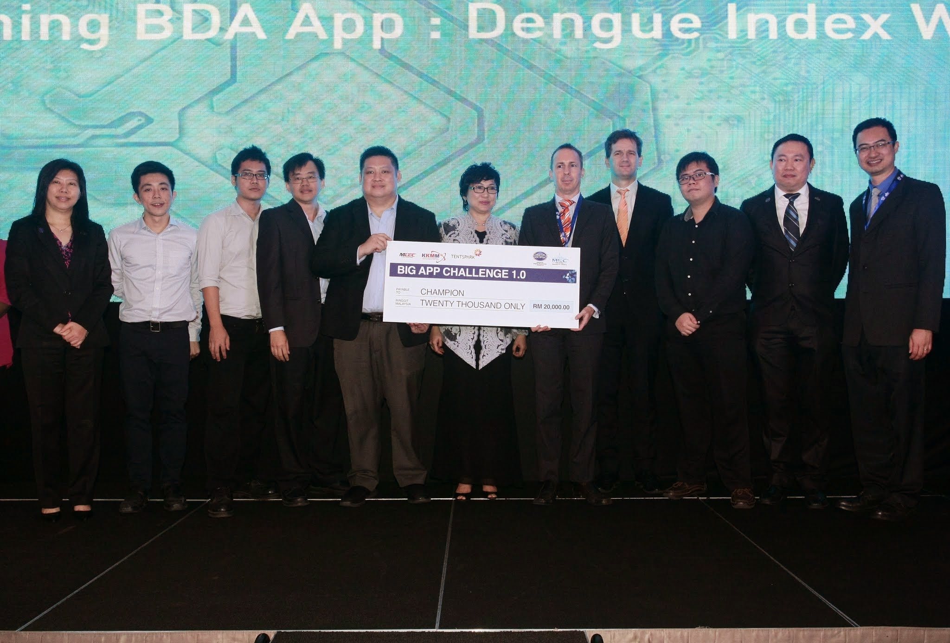
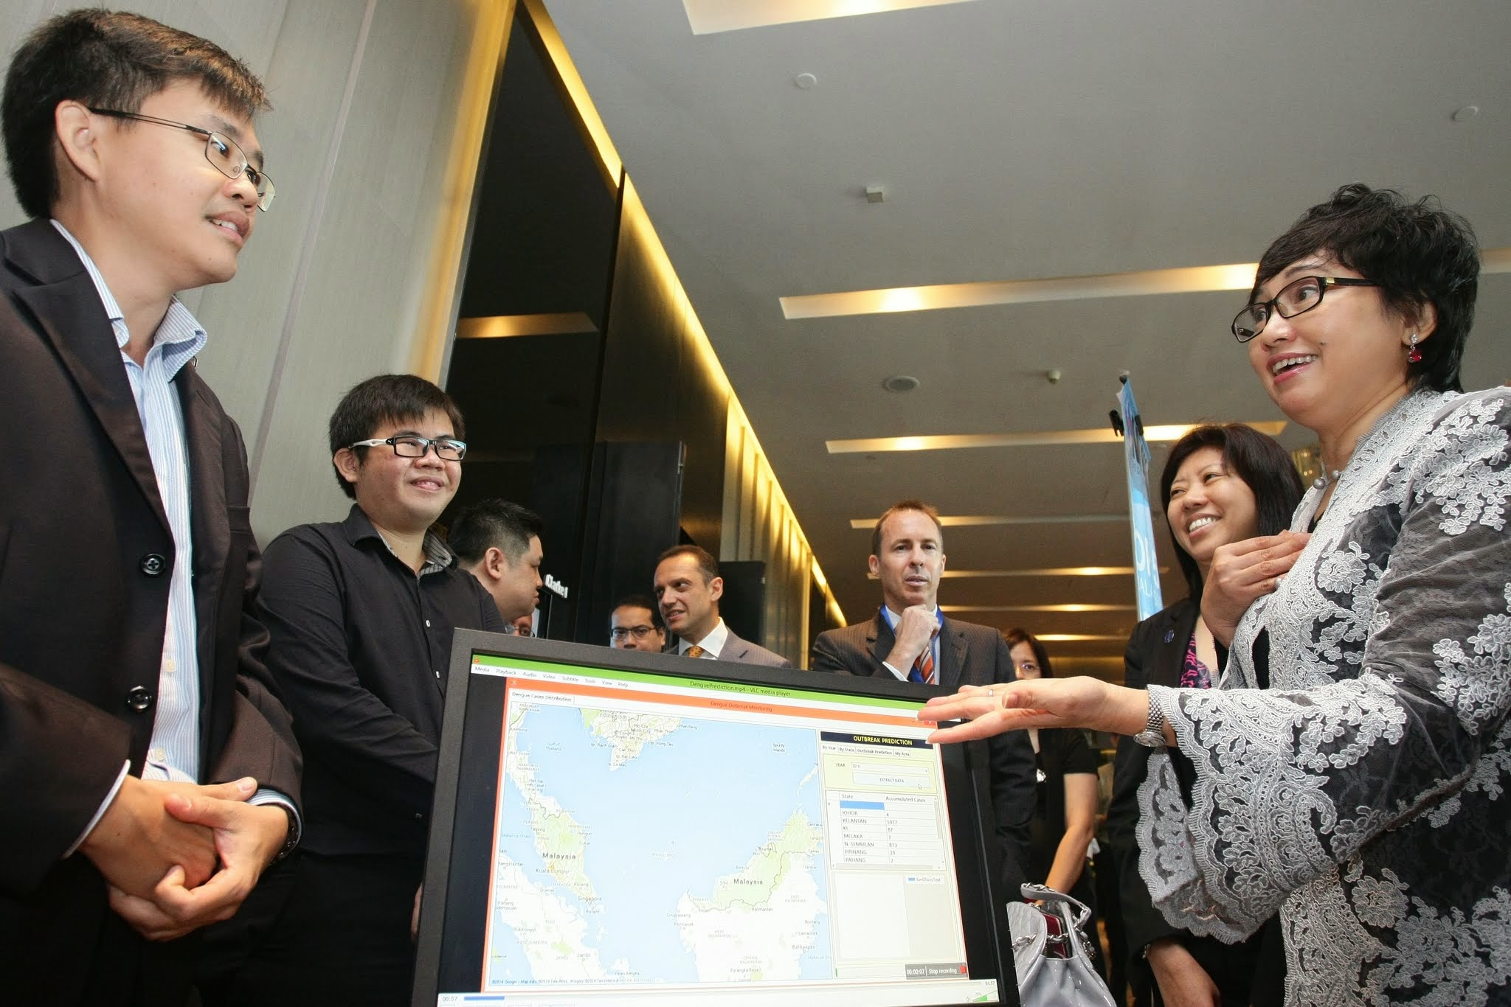
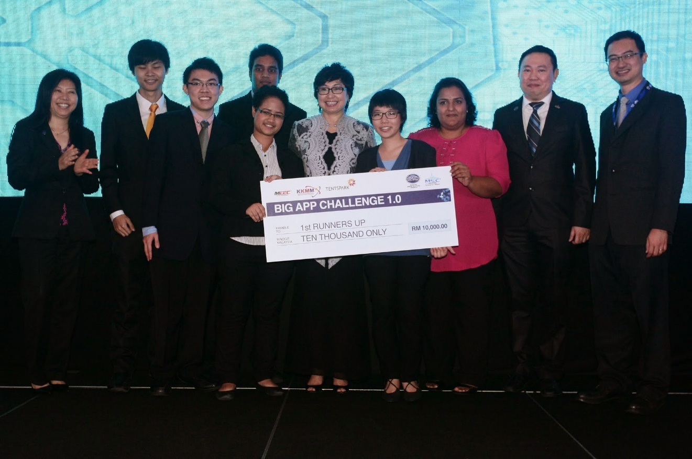
BDA Conference and Award Ceremony

Slide 14
So, What’s next for BAC V2.0?

Slide 15
BAC V2.0 Expectations
Larger scale compare to BAC V1.0
Regional participations – ASEAN
High impact end product for use cases and continuity – BDA MSC Startup Programme
Data-driven product/solution from open datasets– Data.gov.my, Cyberview, Telcos
Higher product/solution submissions compare to BAC V1.0
Press mentions – local and regional

Slide 16
Lesson Learned
Ideation class brought valuable impact to the participants, however need respectable mentors from industry- well known developers, hackers, programmers and BDA experts
Ample and sufficient time for participant’s development and showcase (demo)
Track, monitor, reminder and guidance during participant’s development phase
Logistic: Wi-fi connection, proper booth showcase?

Slide 17
BAC V2.0 Framework
4 main categories – Smart city, Transportation, Retails & Telecommunication – development will be using potential datasets from Cyberview, SPAD, Prasarana, Fusionex & Telcos (Digi, Celcom, Maxis)
These 4 categories can be top up with public datasets from data.gov.my
Structure and framework of the event (concept, logistic, duration etc.) propose by event partner (your side)
Encourage sponsorship

